Slide 1
BDSN PROJECT
Prepared by: Sanket DAS (A21028)
PRAXIS BUSINESS SCHOOL, KOLKATA

Slide 2
PROBLEM STATEMENT
A retail company “ABC Private Limited” wants to understand the customer purchase behavior (specifically, purchase amount) against various products of different categories. They have shared purchase summary of various customers for selected high volume products from last month. The data set also contains customer demographics (age, gender, marital status, city_type, stay_in_current_city), product details (product_id and product category) and Total purchase_amount from last month. Now, they want to build a model to predict the purchase amount of customer against various products which will help them to create personalized offer for customers against different products

Slide 3
DATASET DESCRIPTION
The dataset consists of sales transactions captured at a retail store. Here we will explore and expand our feature engineering skills and day to day understanding from multiple shopping experiences. This is a regression problem. The dataset has 550,069 rows and 12 columns.
Data Sets: Analytics Vidhya Hackathon : https://datahack.analyticsvidhya.com/contest/black-friday/#ProblemStatement
Problem: Predict purchase amount

Slide 4
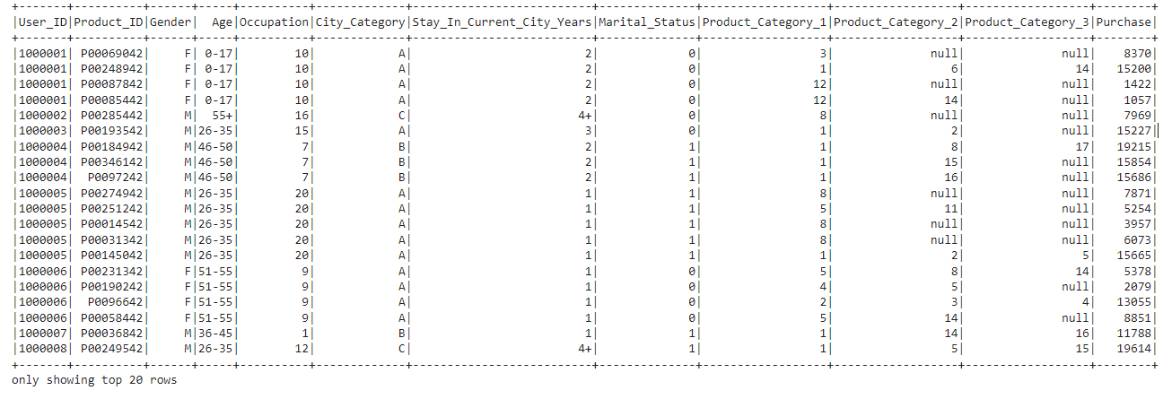
DATA SET

Slide 5
DATA VISUALIZATION

Slide 6
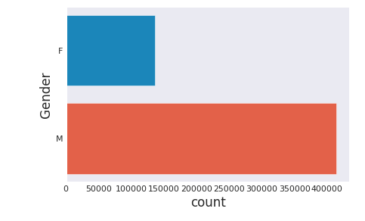
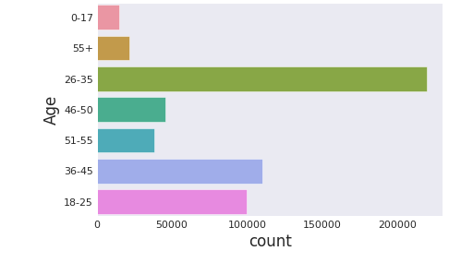
In this dataset most of the purchasers are Male in the Black Friday Sale
Maximum purchases is done by youth people belonging to the age group between 26-35

Slide 7
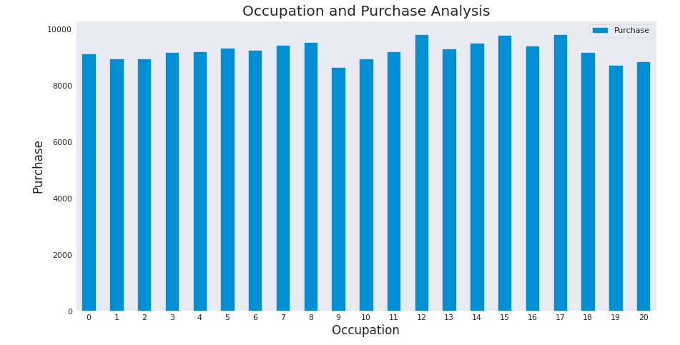
All the categories are purchasing in average manner, the mean is in uniform distribution.

Slide 8
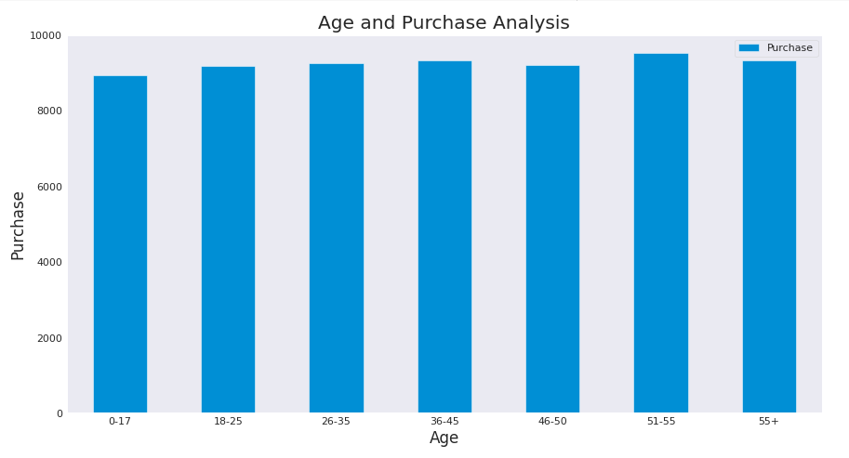
Here also most of the categories are purchasing in uniform manner.

Slide 9
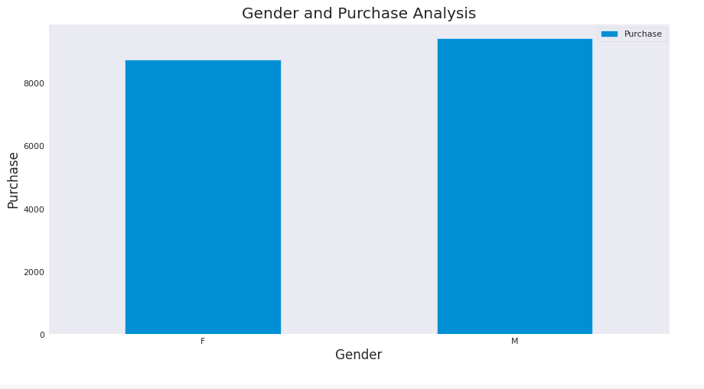
Here there is a slight difference in the purchase pattern amongst males and females.

Slide 10
DATA PREPROCESSING

Slide 11
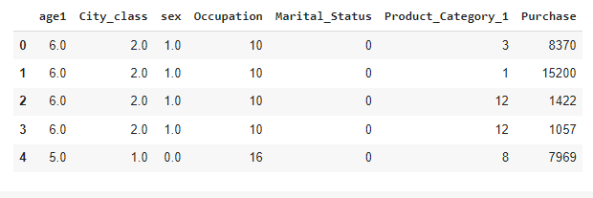
We need to pre process some of the variable so as to fit the model on top of it. We will transform the feature through the label encoder technique so as to use the important variables for modeling.

Slide 12
Machine Learning Models and Evaluation
We have used Linear Regression to evaluate the model

